Slide 1

Project Proposal
International Trade
Exploration & Prediction
Using Knowledge Graph
Tejas Bharambe
Soojung Choi
University of Southern California
DSCI558

Slide 2



Objective
International Trade Exploration & Prediction Using Knowledge Graph
KG construction
International trade of countries
FTA (Free Trade Agreements)
Countries’ economic & population information
Analyzing, Visualizing and Forecasting using KG
The product manufactured in 1 country is exported to which all countries?
What are the top products traded between countries?
How will the trade value change over time in the near future?
How will the trade change when a country reaches FTA with the US?
ex> (:Yes)<-[has FTA with US]-(:Country)-[export value is]->( :$?)
[US Export value over time]
∵ The world trade data is massive
2008 | 2009 | 2010 (FTA) | 2011 | 2012
$35.5B | $28B | $36.7B | $41.8B | $40.1B
Total amount of trade in 2021 | 22.3 trillion USD
Total countries that actively trade | ~150
Total number of products traded | ~5200
2002 | 2003 | 2004 (FTA) | 2005 | 2006
$15.4B | $16.5B | $18.4B | $18.7B | $24.6B
FTA
2016 | 2017 | 2018 | 2019 | 2020
$114B | $127B | $118B | $103B | $122B
?

Slide 3
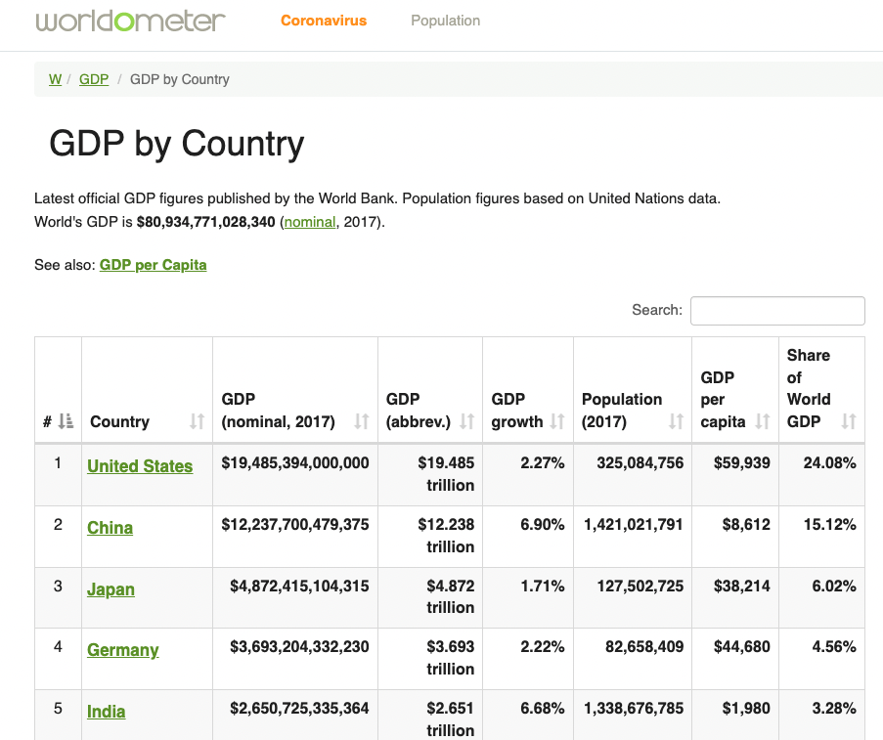
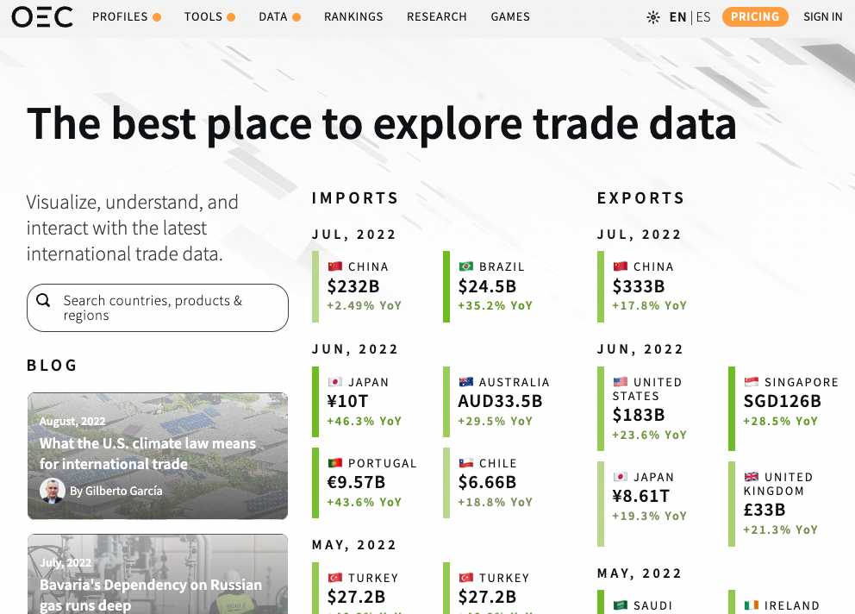
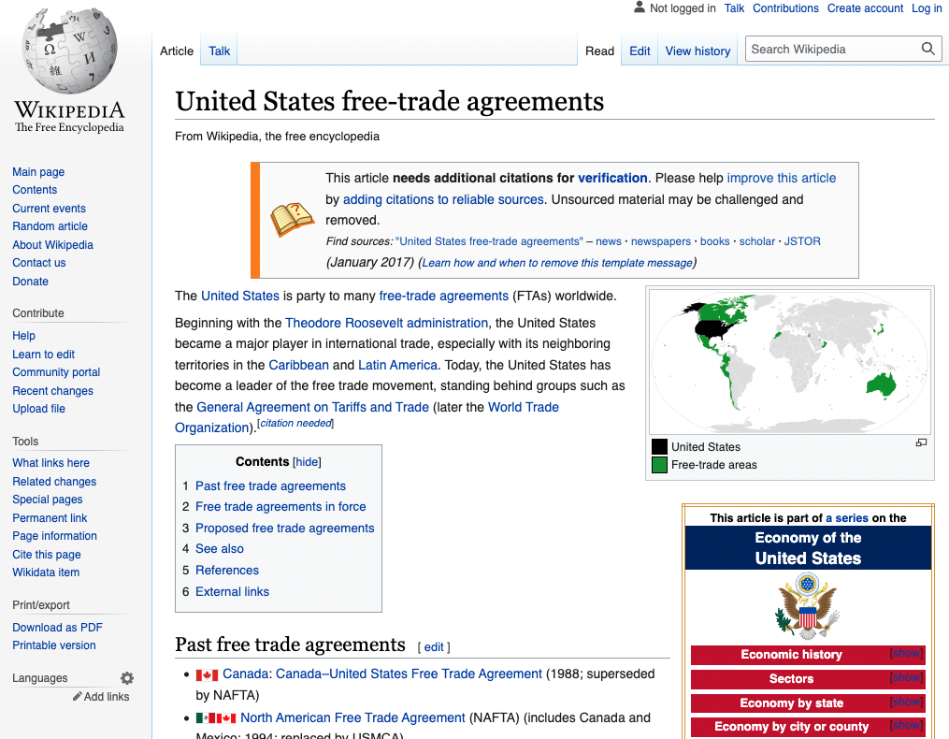
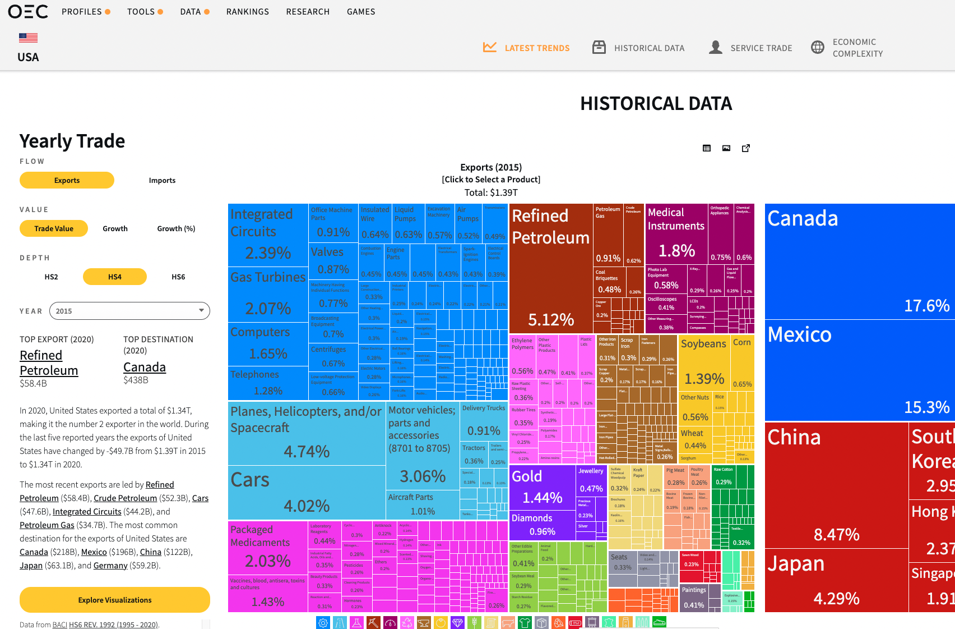
Data Source
World Trade Data
1. Countries involved in trade
2. Products that they trade
3. Year
4. Import/export trade type
5. Amount of trade in $
6. Countries’ population and economic information
Worldometer (structured)
https://en.wikipedia.org/wiki/
Yearly population
statistics
Add supporting country information
OEC (Unstructured)
https://oec.world/en
1. Product
(Product (meat of some animal),
Product sub category (meat),
product main category
(animal products))
2. International trade data
Wikipedia (structured)
https://www.worldometers.info/
1. FTA Country list
2. Countries' economic information
(GDP, gini coefficient,
human development index, ease-of-doing-business rank)

Slide 4



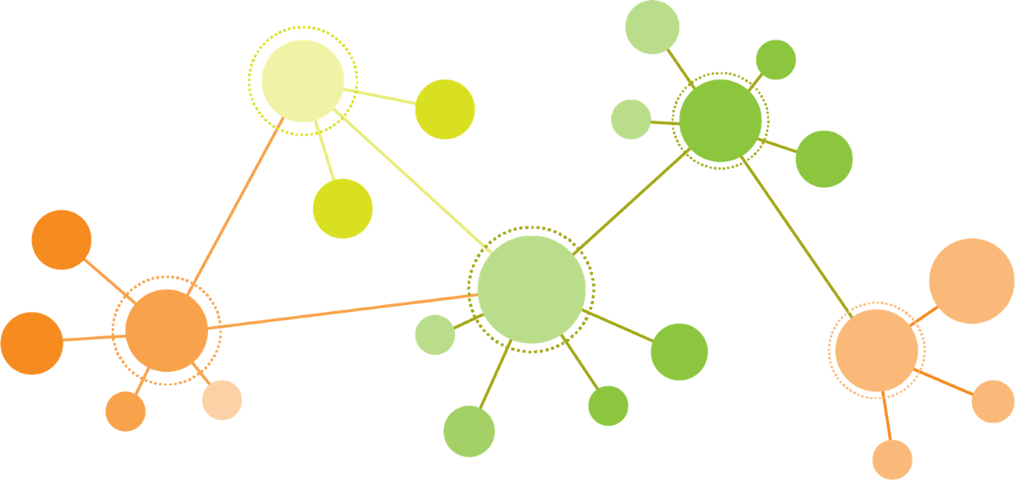




Technical Challenge
Data Acquisition
Crawling
Scrapy
Beautiful soup
Ontology/Entity Linking
Using various libraries
RLTK
KGTK
RDFLib
WAT
KG Deployment
Neo4J
Jena
Web App Deployment
Building Streamlit App
ex) Dealing with bidirectional and complex relationships
China imported soybeans from US worth $1B in 2020
US imported soybeans from China worth $0.5B in 2020
China imported soybeans from US worth $1B in 2019
US imported soybeans from China worth $0.5B in 2019
India also imported soybeans from China worth $0.2B in 2020
China also imported soybeans from India worth $0.25B in 2020
Machine Learning
Scikit-learn
NLTK/Topic Modeling
End User
Visualization
NetworkX (Graph Viz)
Plotly (Data Viz)

